Slide 1
Firewalls and Firewall Utilities in Linux (iptables)
Bryan Vanek
10/5/16
Cyber Dawgs Presentation

Slide 2
Objectives
To understand exactly what a firewall is, and why it’s important in the field of Cyber Security.
To understand how ports work, and to go over some important port numbers to keep in mind when configuring any firewall.
To explore the iptables firewall configuration utility in Linux.
Learn the differences between Input, Output, and Forwarding
Learn the differences between Accept, Drop, and Reject
Understand the use of forwarding with pre- and postrouting.
Learn how to write policy chains
Go into useful commands and flags for iptables
Understand the use of state

Slide 3








So…What’s a Firewall?

Slide 4
More formally speaking, a firewall is…
At its core, it’s a system designed to prevent unauthorized to or from a private network.
Firewalls can be implemented via hardware OR software
Hardware: security appliances, physically turning ports on/off.
Examples: firewalls built into routers, Cisco/Juniper PoE services
Much better for larger scale configurations
Software: Installed on a computer and takes care of port forwarding/network trafficking.
Examples: Windows Firewall, firewalld, iptables
Better for smaller organizations or individuals (ESPECIALLY for people who move around)

Slide 5
Different Types of Firewalls
Packet Filtering: examining each incoming packet and decide whether or not to allow it in.
Each packet has a header that identifies what kind of packet it is. Written rules will then determine what we do with that piece of data.
This is what we’re going to learn how to do today!
Web Application Firewall: Ways that browsers handle HTTP (averts attackes that SSL would catch)
Using a Proxy Server: Hiding a network address and connect through another means.
You can set up a proxy yourself for the lab today!
Circuit Gateway: Once a connection is made, no need to check those packets. Relies on the three-way handshake (TCP) or connectionless (UDP).

Slide 6

Why are Firewalls Important?
Prevents any kind of intrusion on the network
As explained by Alex last time, there are MANY ways people can get in
Piggyback worms, Trojans, root kits (AHH) and even get root access
Can also keep those who aren’t as aware at bay
Prevent users from launching Ping, make them log in via one method.
NOTE: This is only the first line of defense!

Slide 7




So…what’s a port?
HA. HILARIOUS.

Slide 8




I like to think about it being like a mailbox…
…and each one has four states…
Two-way opening
Only receive
Only give
Completely blocked

Slide 9


So as you can see, it’s not…
…HARD TO PORT!!!

Slide 10
Now then, let’s get into the nitty gritty…
A port is the means with which a computer ‘listens’ for different kinds of network traffic.
Each port is literally only a two way tunnel
Ports are identified by Port numbers, ranging from 0 to 65535
Why that number? Headers in a packet!
Ports 0-1023: Well-known or System Ports. Lots of important ports here.
Ports 1024-49151: Registered Ports. Registered services use these. (Openfire!)
Ports 49152-65535: Ephemeral Ports. Experimental or private services.
When configuring firewalls, it’s usually a good idea to know these numbers!
On to some important ports…

Slide 11
ImPORTant Ports
FTP: File Transfer Protocol – Transfers files between a client and a server.
Port number 20. Used in a lot of older systems. Also used by Firezilla.
VERY INSECURE. Doesn’t do encryption; sends files over plain text.
SFTP: FTP over SSH (port 21). More secure.
SSH: Secure Shell – Unix based command system interface.
Port number 22. Helpful with server control. You use this to get into GL!
A good option for remote login; commands, files, and passwords are encrypted. Also does authentication.
Not perfect; vulnerabilities have been found!
Telnet – Like SSH, but has NO security implementations. (Port 23)
IF SOMEONE EVER USES THIS, SLAP THEM AND MAKE THEM USE SSH.

Slide 12
Important Ports (Cont.)
SMTP: Simple Mail Transfer Protocol – delivers email
Port 25. Used by a lot of common email clients (Outlook Express!)
Needed for email servers; used in tandem with other protocols
POP3 (Port 110) and IMAP (Port 143) handle delivery.
DNS: Domain Name Servers – The way computers resolve host names
Port 53. Can be thought of as a phone book!
Critical to keep up for web servers
HAS VULNERABILITIES. Namely cache poisoning (uses fake address to divert)
DHCP: Dynamic Host Configuration Protocol – automatic IP provision
Port 67. Crucial for IP management/web servers.

Slide 13

Important Ports (Cont.)
HTTP: Hypertext Transfer Protocol – Connects you to the web
Port 80. Transfers files and pages over the web. HTML then formats
If you block this, you can’t connect to certain web pages!!
However, HTTP by itself is insecure! Man-in-the-middle attacks can see stuff!
HTTPS: HTTP over SSL /TLS (Secure Socket Layer/Transport Layer Security)
Port 443. Requires authentication; encrypts and decrypts pages
Not perfect (HEARTBLEED), but still very secure! Locked down as of now
Web Caching: sometimes called HTTP Proxy
Port 8080. Allows you to store web pages!
Necessary to have on if you ever want to utilize proxies

Slide 14
Need to talk about one more thing…
TCP vs UDP: Transmission Control Protocol vs User Datagram Protocol
Reliability vs Speed; Connection oriented vs connectionless. Both used by IP.
What kinds of protocols do you think belong in one of these? Applications?
ICMP: Internet Control Message Protocol
Used by network devices for reporting errors.
Tools: ping, traceroute, echo
Unless you’re the admin, DISABLE THESE. Ping = bad people knowing when you’re server is up (or down).
Wanna learn more about port numbers?!?
http://packetlife.net/media/library/23/common_ports.pdf

Slide 15

NOW IT’S TIME FOR THE FUN STUFF!
(or at least I think it’s fun…)

Slide 16


What is iptables?

Slide 17
Iptables: Software Firewall
Can be thought of as a flexible firewall utility for Linux operating systems.
Unlike something like Windows Firewall, you can configure everything yourself!
Uses Policy Chains in order to perform Packet Filtering.
Usually comes pre-installed on a lot of Linux distros. Some, however, are migrating…
Firewalld is another, more modern version of iptables.
Uses a lot of the same commands as iptables; provides a little more flexibility.
More commonly found in Fedora (Fedora 21 and higher)
Important to understand iptables before you look at firewalld
GUI Alternatives are also available (Turtle, Firestarter), but being able to work with the command line is an essential when working in Linux!
Note: you MUST be the root user in order to manipulate/change things in iptables.

Slide 18
The Three Chains: IFO
I = INPUT: Traffic inbound from outside to your local host
Example: a user is trying to SSH into your server. Unless the IP and port match the current rules, traffic will not pass through.
O = OUTPUT: Traffic that your local host wants to send out
Example: a user from your local host wants to ping google. Unless the local host allows it, the connection attempt will not be made.
F = FORWARD: Traffic that uses your local host as a router
In other words, packets need to be passed from one interface to another (such as eth0 to eth1)

Slide 19
Forwarding Expanded on
Used primarily with NATing-specifically SNAT (Source) and DNAT (Destination)
IPTables works together with another utility called netfilter to tell the kernel what we want to do with our packets
To use this appropriately, you will need two other chains:
PREROUTING: destination NATing/DNAT. Can be thought of as the first, preliminary action that’s performed on the packet before it hits the system
POSTROUTING: source NATing/SNAT. Can be thought of as the last action performed on the packet before it’s sent out.
***In both cases, anything else on the Linux box itself (routing or packet filtering) will see the packet going to its ‘real’ destination, and will see the packet as unchanged.***

Slide 20
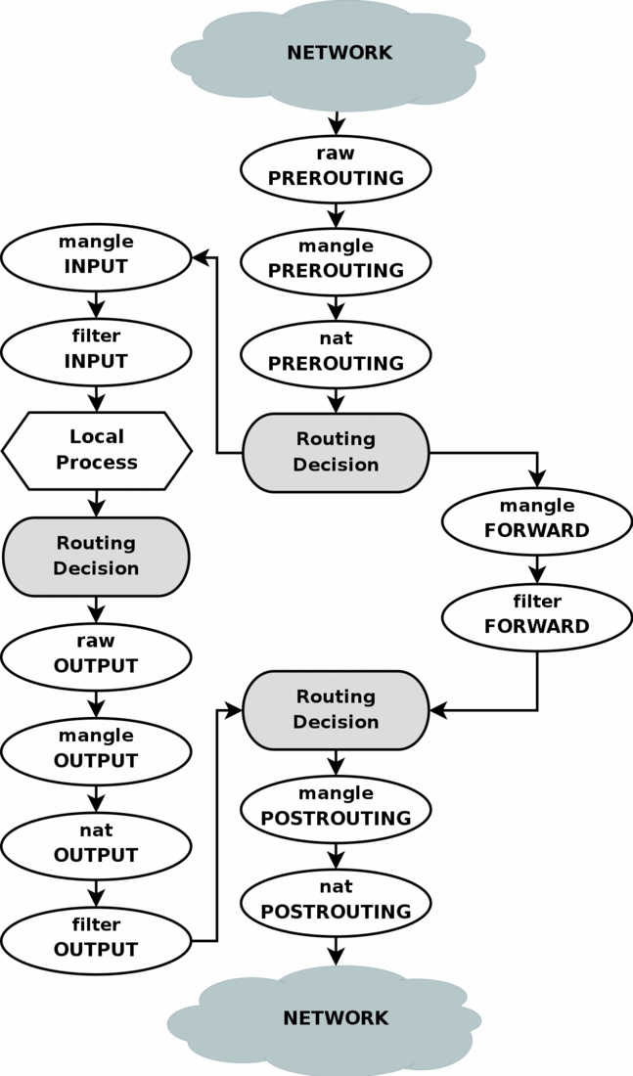
A view of a network connection through a packet filtering firewall
Three different tables within iptables:
Raw: what the policy is actually doing to the packet (accepting, rejecting, etc.)
Mangle: changing TOS, QOS.
NAT: Any kind of manipulations to SNAT and DNAT.
** Except for dealing with NATing, the actions performed in the raw table are the important ones!!
We will not be going in depth on NATing with netfilter + iptables, but it is crucial to be aware of in the field.

Slide 21
Chain Policy + Default Behavior: ADR
Like the chains, there are three actions that the firewall can take.
A = ACCEPT: Allowance of a connection
D = DROP: Drop the connection, and pretend like it never happened
R = REJECT: Drop the connection, and send an error
Difference between Drop and Reject?
Drop will prevent someone from knowing your system exists (no error message = generic web browser error). Reject WILL LET SOMEONE KNOW THAT THE FIREWALL BLOCKED THEM.
Each chain has a given default policy behavior-most of the time, each will be set to ‘Accept’
**AS A SECURITY PROFESSIONAL, YOU SHOULD ALWAYS CHANGE THIS TO DROP**
All-or most-traffic should be expected when possible.

Slide 22
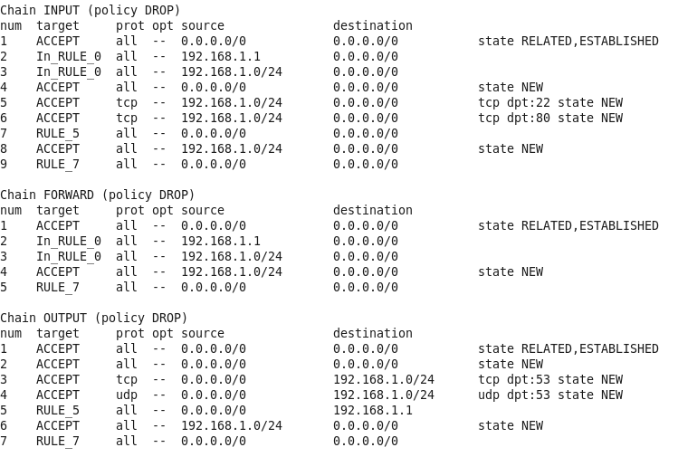
Time to start using iptables!
Your first command: iptables –L
Can optionally append the –v and –n flags for more info and numeric input
To set default policies:
iptables -P <name of chain> <name of policy>
Ex: iptables –P INPUT DROP

Slide 23
More of the basics
Clear a current set of rules: iptables –F (f = ‘flush’)
Delete a rule on a specified line number: iptables –D [chain] [line number]
Ex: iptables –D OUTPUT 4
**This is a reason why line numbers can be very important-no easy way to manipulate this otherwise, so use the –n or --line-numbers tags where you can!**
Save your current iptables configuration: iptables-save OR service iptables save
**certain distros will not save your iptables configuration once you’re done with it!**
Iptables-save and service iptables save may also not work. If this fails, specify a cronjob that will write rules for you/save and keep a file.

Slide 24
Constructing your first simple chains
Use case 1: drop all incoming SSH connections.
Full command: iptables –A INPUT –j DROP –p tcp --dport 22
Breaking it down:
[-A INPUT]: appends to the end of the INPUT firewall ruleset.
[-j DROP]: instructs the rule to DROP connections. (j = jump)
[-p tcp –dport 22]: specify the tcp protocol suite & the SSH destination port.
** ssh will work in place of 22 **

Slide 25
Constructing your first simple chains (continued)
Use case 2: Allow all incoming SSH on an interface named ‘enp0s3’ (a little more complicated)
Two commands needed; SSH = two-way connection!
iptables –I INPUT –j ACCEPT –p tcp --dport 22 –i enp0s8
iptables –I OUTPUT –j ACCEPT –p tcp --sport 22 –o enp0s8
New things:
[-I INPUT/OUTPUT]: inserts at the beginning of the INPUT/OUTPUT rulesets
[-i enp0s8]: specifies the incoming interface for connections.
-o is for outgoing interface connections
--sport is a lot like --dport, but stands for ‘source’ port.

Slide 26
The almighty catch-all and evaluation precedence
Catch-alls: Another way to implement a default behavior for a chain.
Catch-alls should be implemented for all protocol suites
Use case 3: Very simple to implement w/ two commands:
iptables –A INPUT –j DROP –p tcp
iptables –A OUTPUT –j DROP –p tcp
Works for ICMP and UDP as well!
Note how catch-alls are implemented with the –A flag.
This is because iptables evaluates rules from start to finish!!! If a catch-all were at the beginning of the rule set, no traffic would be allowed through.
This should usually be the last thing you do, and this is essentially equivalent to iptables –P INPUT DROP for specific protocols. Useful as another line of defense.

Slide 27
The importance of state
iptables is an example of a stateful firewall, meaning that it can track the operating state/characteristics of any network connections traversing it.
Important since it can distinguish between legitimate packets!
If it weren’t for this, people could circumvent the filter by communicating with the server as though they are responding to it, rather than initiating one!
Four different kinds of states to be concerned with:
NEW: packets that belong to a new connection
ESTABLISHED: packets that belong to an existing connection
RELATED: packets belong to a related existing connection (caching)
INVALID: unidentified packet
We can manipulate state this using the –m (match) flag, and then specify states using the --state subcategory specification.

Slide 28
The takeaway? State will handle 99% of your firewall problems for you!
The first thing you should be doing is checking to make sure the incoming packet matches what’s expected.
Use case 3: Allow legitimate SMTP traffic on an SMTP server (three tasks)
If someone already managed to connect or route through and connect to the server, then that is a valid connection.
iptables –A INPUT –j ACCEPT –m state --state ESTABLISHED,RELATED
If a person is trying to establish a new SMTP connection, then this will need to be established at the beginning.
iptables –A INPUT –j ACCEPT –m state --state NEW –p tcp --dport 25
Otherwise, the packet is not legitimate for the purposes of the server and should be dropped.
Iptables –A INPUT –j DROP –m state --state NEW,INVALID
Again: precedence is important! The drop should come at the end!!

Slide 29
Specific connections and port behavior
You can also use iptables for whitelisting/blacklisting purposes. Useful in that it can use CIDR or slash notation.
Use case 4: block all ips within the 103.* subnet, all ips within the 221.22.* subnet, and all traffic on port 4565 within the 56.45.11.* subnet.
CIDR notation makes this a breeze:
iptables –A INPUT –j DROP –s 103.0.0.0/8
Iptables –A INPUT –j DROP –s 221.22.0.0/16
Iptables –A INPUT –j DROP –s 56.45.11.0/24:4565
** -s basically stands for ‘source.’ **
There’s also a way to do this using –m (uses the iprange capability)

Slide 30

THANKS, GUYS!!!
Hope you learned something today!
Questions? You can email me below!
bvanek1@umbc.edu

Slide 31
Lab time!!
Install HTTPD and Openfire on CentOS 7 + migrate to IPTables
Create tcp catch-alls for your input and output chains.
Implement state checks: allow established + related traffic, deny new + invalid traffic.
Enable HTTP and HTTPS
Be able to access your HTTPD server (you need to do more here with output catch-all on!)
Specify this rule for both interfaces (what should we take away?)
Enable incoming and outgoing SSH and check for legitimate SSH traffic using state
YOU HAVE TO SPECIFY THE INTERFACE; NO BLANKET INTERFACE.
Enable mailing protocols and name resolution (remember the ports?!)
Block two very insecure protocols
Prevent your server from being able to access Facebook and Yahoo. (-m will help here)
Prevent USERS from performing traceroute, netstat, or ping USING A SINGLE RULE
Make rules persistent upon logoff (SNAPSHOT before you try this!!)
Find a way to prevent a DoS attack. (there are multiple solutions to this, but we didn’t go over any of them…figure it out!)

Slide 32
Iptables quick cheat sheet
iptables –L: Lists the current rules set in iptables
-n: lists line numbers
iptables –F: Clears the current ruleset
iptables –P [chain] [policy]: Sets the default policy of a chain.
Iptables –D [chain] [line number]: Delete a single rule on specified line number.
Chain writing options
-A [chain]: Appends a chain to end of the list of rules
-I [chain]: Inserts a chain at front of the list of rules
-j [policy]: ‘jumps’ or activates a particular policy
-p [ip protocol]: specifies rule to protocol (ex. tcp, icmp)
--destination-port [port #]: destination port # (80, 22)
--source-port [port #]: specifies source port # (same as above)
-i [interface]: specifies an interface for INPUT. (Use –o for output).
-m [match parameter]: used for checking the validity of a packet. Good to use in tandem with state.
iptables-save > [iptables file location]: script that saves your rules upon logoff.
iptables has a man page!! Be sure to consult that if you have questions.
Policies |  | Chains
ACCEPT | Allow in/out | INPUT | Incoming connects
DROP | Don’t allow (no error) | OUTPUT | Outgoing connects
REJECT | Don’t allow (w/ error) | FORWARD | Routing + Proxies

